Slide 1
<Analysis of Covid 19>
<Dharik Arsath>

Slide 2
Abstract
For this project I have used Corona Dataset from WHO(World Health Organization ) which is the official dataset for the corona.
We have been living with this covid 19 for almost a year now and still the cases were not dropping to zero. So this Project is all about how things have gone in this last 1 year and this project will make us to realize that how lucky we are to be survived in this pandemic while many lost their lives.

Slide 3
Motivation
The motive of this project is to see how things have gone in the last 1 year and how lucky we are to survive even in this pandemic while many lost their lives. This project can used by anyone since Corona has affected pretty much all the countries in the Earth, so anyone can make use of this project and know how their country has progressed over the years.

Slide 4
Dataset(s)
The Dataset I used here is Corona Dataset from WHO which is the official dataset for the corona virus. This Dataset contains
Date_reported, New_cases,New_deaths,overall_cases and overall_deaths
for all the countries around the world.
Link for WHO: https://www.who.int/

Slide 5
Data Preparation and Cleaning
The preparatory steps I have done in this dataset are
--------→Removing the country_code since that doesn’t add much to our analysis
--------→ Splitting the data into 2020 data and 2021 dataset for clear view of analysis
The Problem I have faced during this project is the mixture of 2020 and 2021 dataset in the same csv file, during the analysis stage 2020 and 2021 data are added together and showed me the result which I didn’t notice for a while, then after few days I realized the error and splitted data into 2020 and 2021.

Slide 6
Research Question(s)
Some of the research questions I tried to solve in this dataset is:
1) Which country is affected the most in terms of new_cases and new_deaths
2) Which country has contained well?
3) How Countries have progressed over the year 2020 to 2021?
4) Which Country is seeing growth in terms of new_cases and new_death in recent times.

Slide 7
Methods
What methods did you use to analyze the data and why are they appropriate? Be sure to adequately, but briefly, describe your methods.
I have mainly used plotting libraries like matplotlib and seaborn in this project to make user to view things more easily than looking at the raw data.
I have splitted the data into 2020 and 2021 to see how things have been going in different countries.

Slide 8
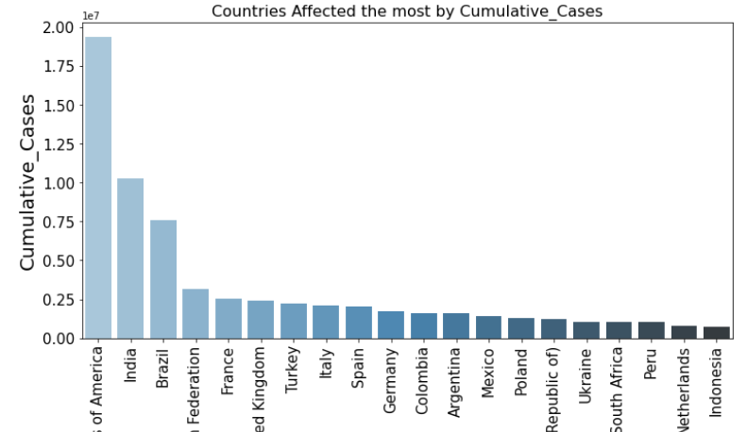
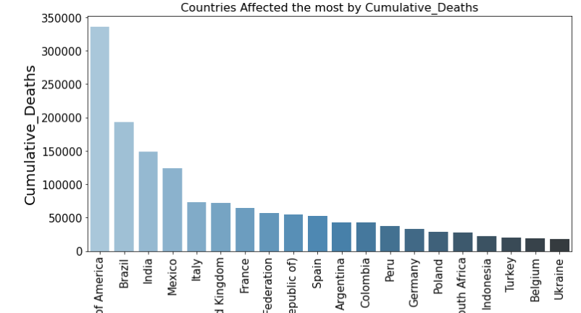
Findings
In 2020 there were around 2 * 10^ 7 Cases reported in USA,1*10^7 cases reported in India which is in second place and Brazil is third country that affected the most.
In 2020 there were around 340,000 Deaths reported in USA which is the maximum,India reported around 200,000.

Slide 9
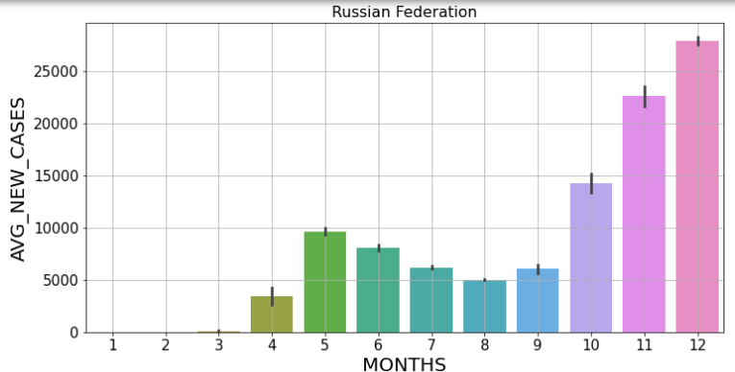
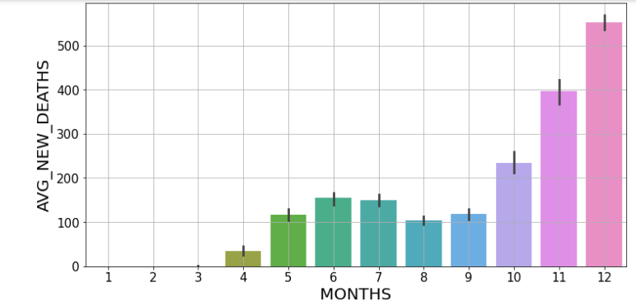
This Plot shows how the cases and Deaths in each month grows, Data and plots available for other countries as well. You can check it out in my Github which is given at last slide.

Slide 10
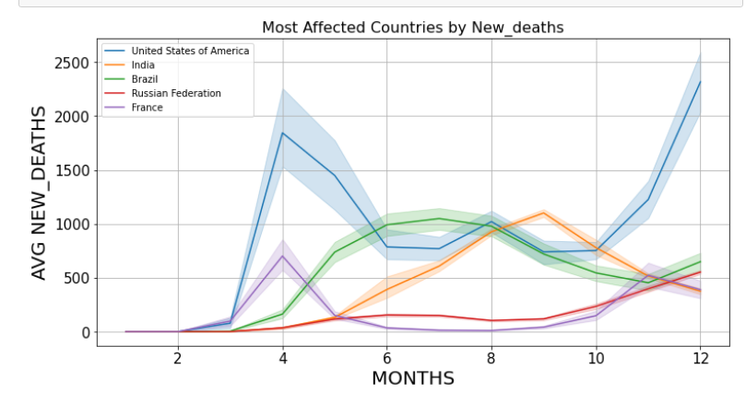
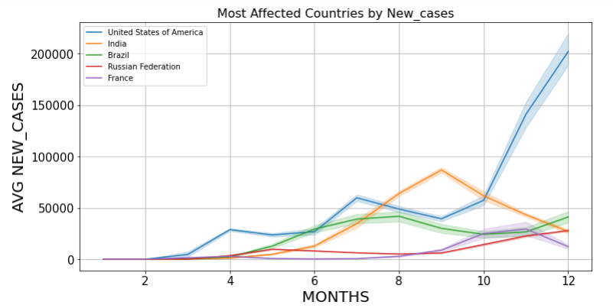
This Plot shows how different countries have been affected by cases and deaths
The Blue line (USA) has seen so much of cases and deaths compared to other countries in 2020.

Slide 11
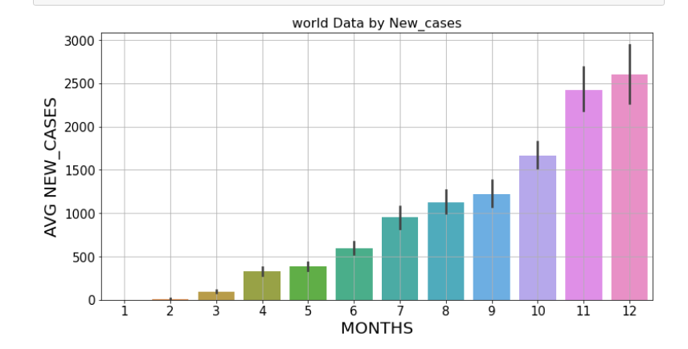
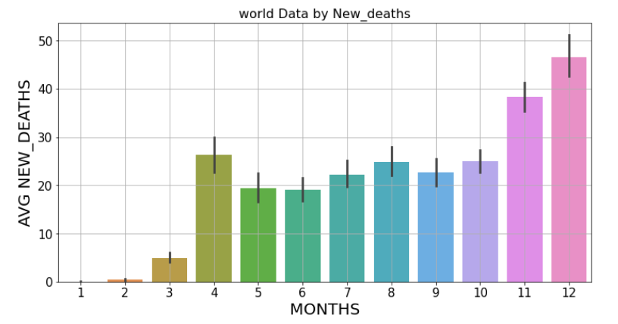
This plot shows how the covid has affected the world in each month by new cases and new deaths in each month

Slide 12
Limitations
Covid has been there for almost a year now , so I have splitted the data into 2020 and 2021. So it is impossible to compare between 2020 and 2021 In same graph
If needed we need some minor changes in the code to compare and contrast 2020 and 2021 cases and deaths
Since this dataset does not come with many features,there were not many possibilities to do indepth research in this dataset
It would be better if we have features like Active cases,District wise case lists etc...

Slide 13
Conclusions
By the end of the analysis of Covid dataset which is taken from the offical website of WHO, we have come to know that USA is the country that is been affected a lot in new cases and new deaths
2021 is a better year for all countries compared to 2020 where the corona has seen its peak in different months In different countries.
After USA, India is the country that is affected the most with its new cases and new deaths. Though India is in second position considering India’s population the Indian government have done fairly good job to keep cases under control.

Slide 14
Acknowledgements
This Dataset was taken from the offical source of WHO https://www.who.int/
Since I have been studying on my own there were no one to discuss the problems that I faced during this analysis, this project was solely done by me and there were no one to support me in this project.
As there is a size restriction not everything is included in the pdf so checkout my github for complete analysis.
Github link: https://github.com/dharik-arsath/Data-science

Slide 15
References
This Whole project is solely done by myself without the help of anyone. By the end of this project I have learned a lot. While doing this project I have taken some help from online websites like geeks for geeks, official documentation of pandas and numpy.

